Slide 1
How to write a summary
Kaijun
Andrew

Slide 2
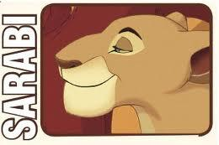
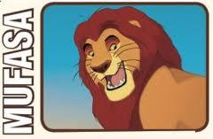
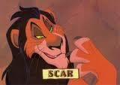
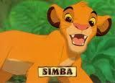
Beginning of the Story
Notes:
in here, we can ask students to take out a pieces of paper to write it down the relationship of the characters

Slide 3
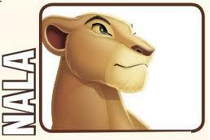
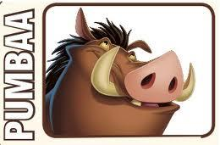
Middle of the Story

Slide 4
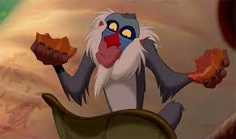
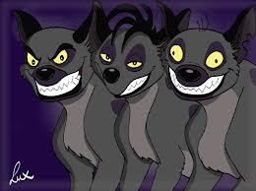
End of the Story

Slide 5
Hand out Directions
1) Read the plot summary
2) Underline the problems, and the ending of the story.
3) Circle the characters
4) Square the places

Slide 6
Answer: Character, Place, Problem
This is a story about a girl named Mulan, in the Movie Mulan. Mulan’s country, China, is at war with the Huns and Mulan risks her life to save her country. The story begins when the Chinese army takes one man from every family. Mulan's family only has one man, her dad, who is crippled and would die in battle. Mulan takes her dad's place and secretly joins the army in his place. Next, Mulan struggles with training but her family guardian, Mushu the dragon, helps her train and pretend to be a man. After much hard work, Mulan finishes her training. Afterwards her group leaves the training camp, and goes to fight the Hun army. Mulan shoots a firework at the mountain during the battle, and lots of snow came falling down the mountain covering the Hun army, winning the battle for her side. However, her leader finds out after the battle she is a girl, and leaves her there. Later in the story, her group is celebrating with the emperor of China, when the Hun leader attacks the emperor. Mulan shows up and defeats the leader and saves the emperor. The story ends with the emperor telling all of China that she is the heroine who saved China.

Slide 7
Transition Words
The story ends
Then, Next, After, Afterwards, Later, However
The story begins

Slide 8
Answer for Transitions
Mulan
This is a story about a girl named Mulan, in the Movie Mulan. Mulan’s country, China, is at war with the Huns and Mulan risks her life to save her country. The story begins when the Chinese army takes one man from every family. Mulan's family only has one man, her dad, who is crippled and would die in battle. Mulan takes her dad's place and secretly joins the army in his place. Next Mulan struggles with training but her family guardian, Mushu the dragon, helps her train and pretend to be a man. After much hard work, Mulan finishes her training. Afterwards her group leaves the training camp, and goes to fight the Hun army. Mulan shoots a firework at the mountain during the battle, and lots of snow came falling down the mountain covering the Hun army, winning the battle for her side. However, her leader finds out after the battle she is a girl, and leaves her there. Later in the story, her group is celebrating with the emperor of China, when the Hun leader attacks the emperor. Mulan shows up and defeats the leader and saves the emperor. The story ends with the emperor telling all of China that she is the heroine who saved China.

Slide 9
Title of the Story:
Who is in the story:
What is the setting and the problem (theme)
First Event (Who, What and Where?)
Second Event (Who, What and Where?)
Third Event (Who, What and Where?)
What happened at the end?

